Slide 1

Campaign Landing Page
Product & Governance Guide
August 1, 2021

Slide 2
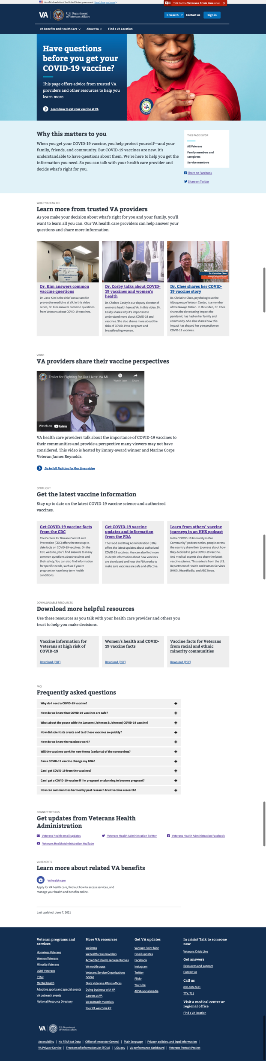
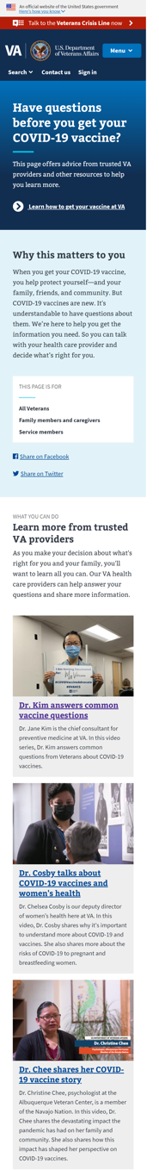
What is the Campaign Landing Page
The Campaign Landing Page (CLP) is a page builder in the VA.gov Drupal CMS which enables VA businesses to create, launch and manage modern, mobile-responsive, accessibility-optimized campaign landing pages to promote marketing or engagement content.
The CLP is:
1-page that links to deeper content which the already exists in the benefit hubs, in videos on YouTube, at separate VA domains (such as publichealth.va.gov), at other VA online destinations (e.g. blogs, PDF factsheets, outreach library).
It is governed and maintained by the digital communications teams at at VHA, VBA, VEO, OPIA and NCA with hands on production expected to be done by their digital marketing teams (e.g. Webmaster or Web Communications lead).
http://www.va.gov/covid-vaccine-questions

Slide 3
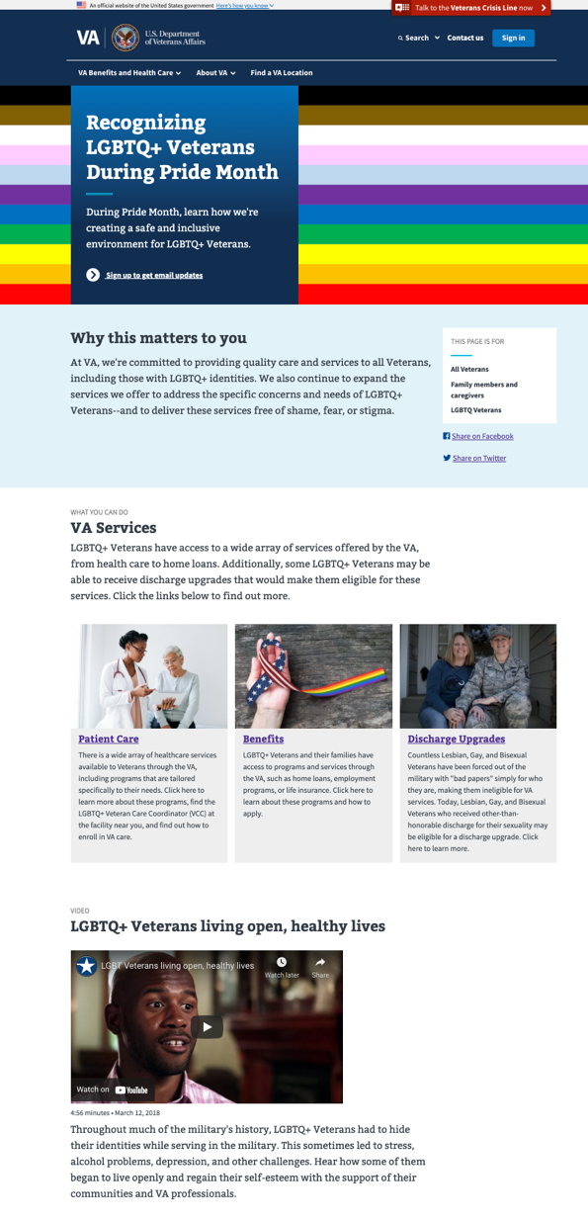
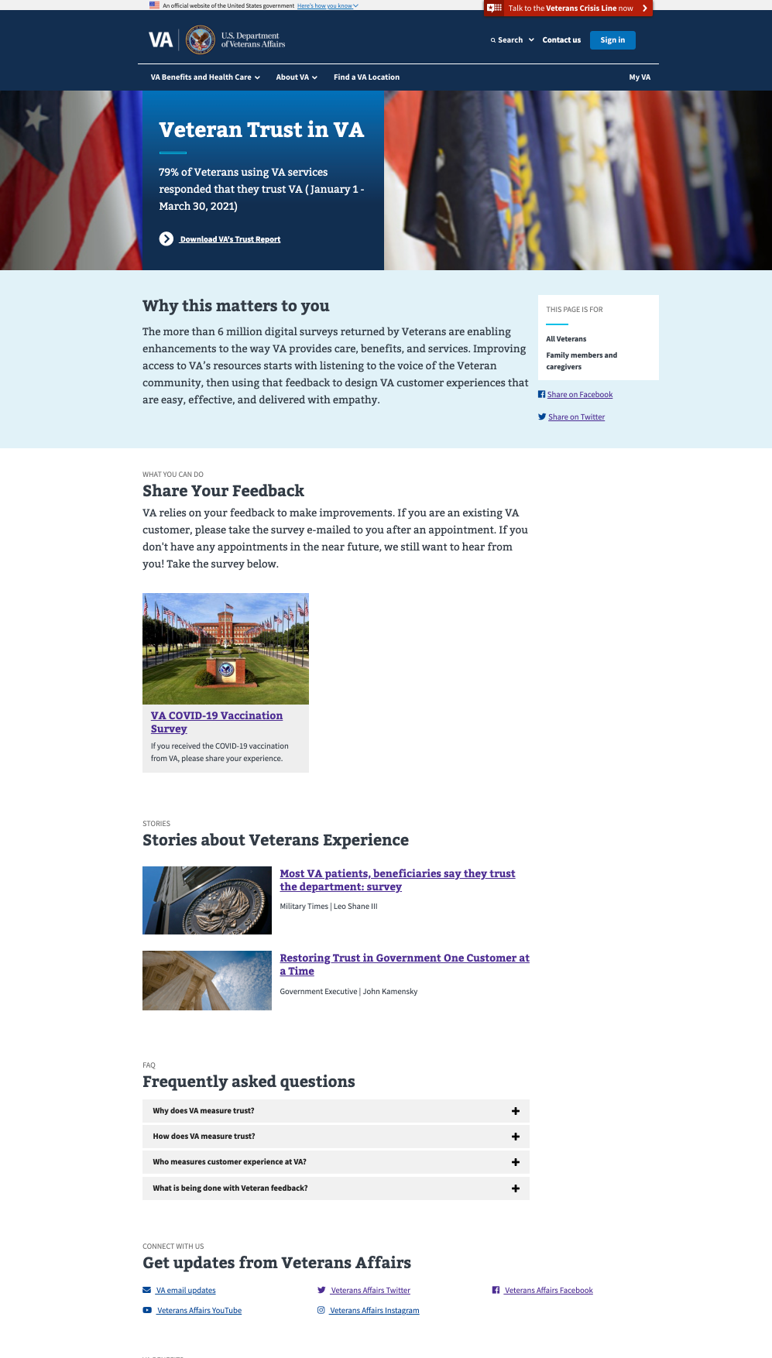
When to use a Campaign Landing Page
Campaign Landing pages are tailored for specific editorial initiatives:
Temporary, time-bound – there should be a specific launch and “take down” date associated with the campaign page
Seasonal, recurring campaigns – e.g. Flu Season, Pride Month – can remain live on-site for re-use and yearly content updates
While most often Veteran-focused, the campaign page may also target audiences other than Veterans -- for example, VSOs, Caregivers, Members of Congress. Examples:
Mission Act
VA Trust Scores
LGBTQ+ Veterans & Pride Month

Slide 4
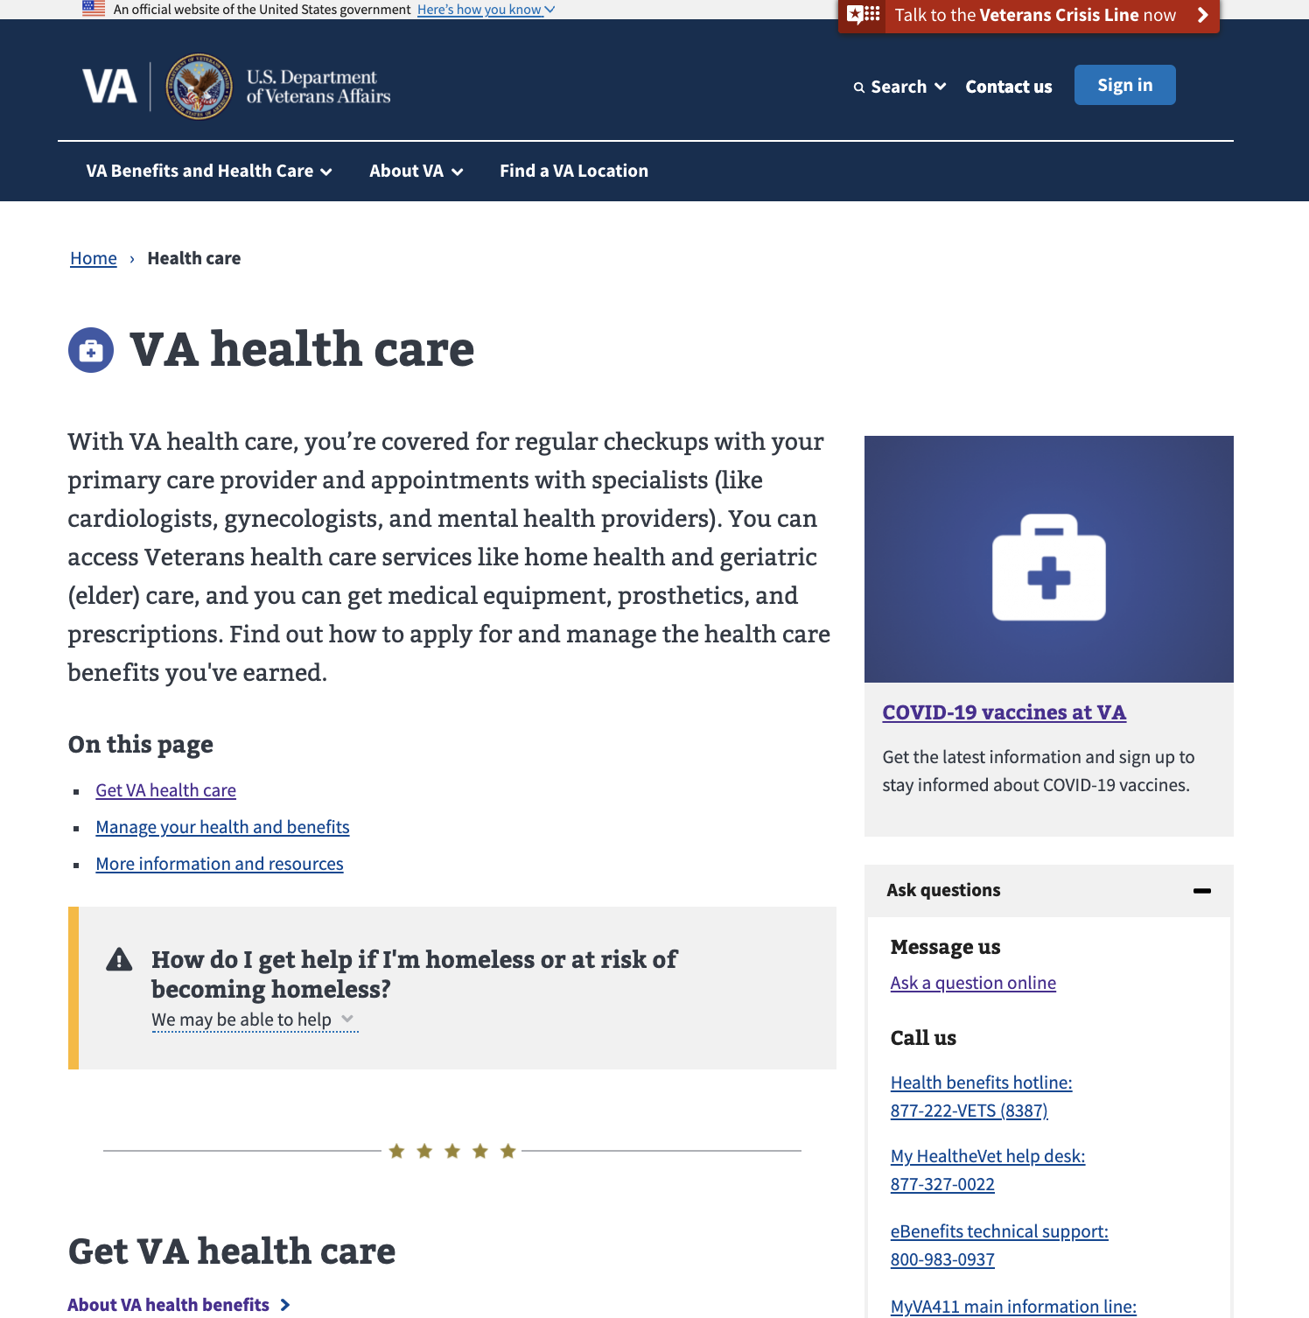
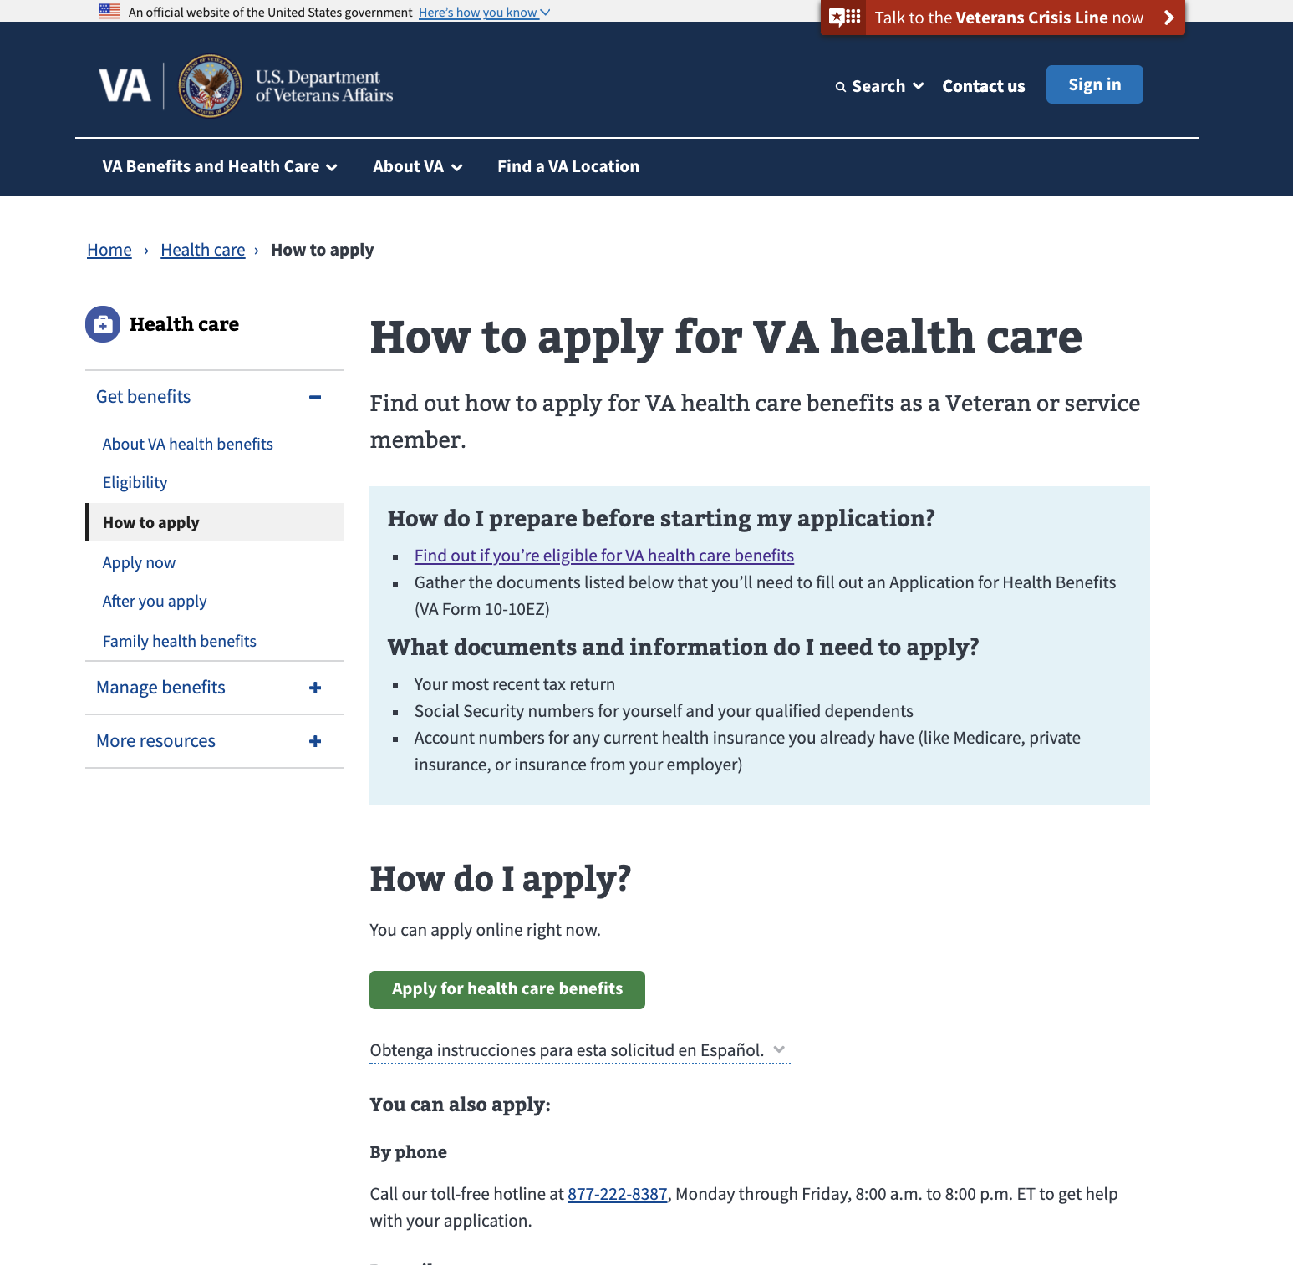
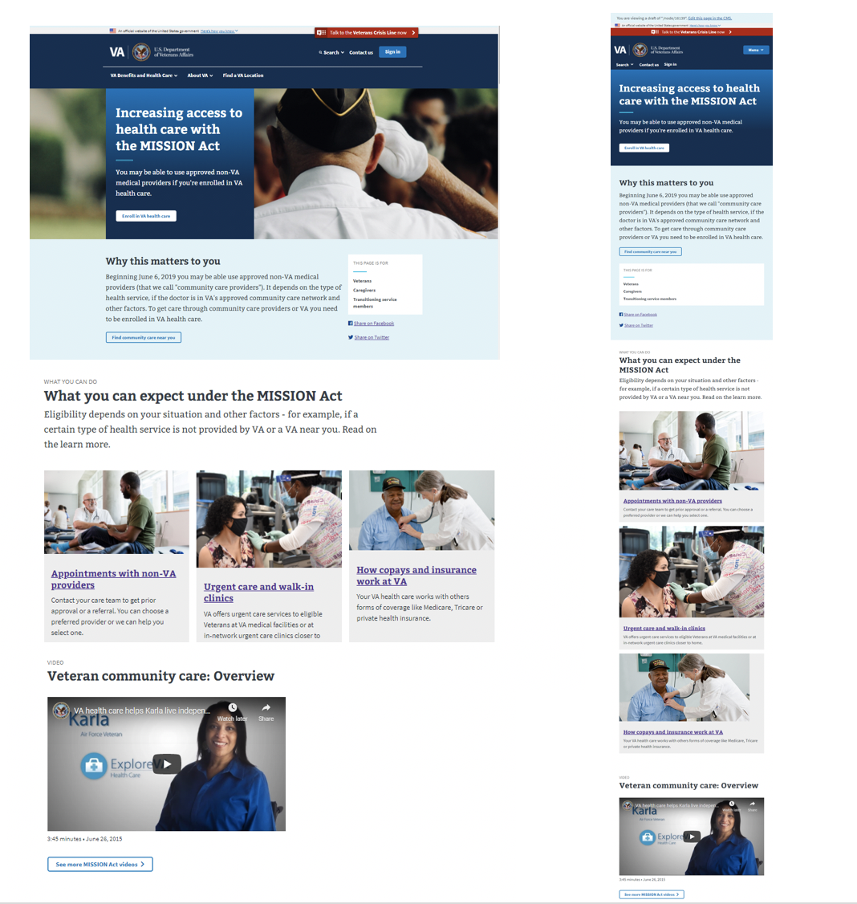
Campaign Landing Page Builder
The Campaign Landing Page is designed to support Tier 2 benefit-related program and engagement content
Tier 1
Veteran-facing benefit and health care content and tools
Primary users
Veterans and other beneficiaries (family members, service members)
Benefit Hubs
Online applications
Tier 2
Benefit-related program and engagement content
Primary users
A mix of Veterans and non-beneficiary audiences who support Veterans (e.g., VSOs, caregivers, etc.)
Tier 3
Campaign Landing Page
Administration and office content
Primary users
Non-Veteran or non-beneficiary audiences (press/media, medical professionals, Congress, vendors and suppliers)

Slide 5
Approved Governance Model*
* Codified by the Web Governance Board on July 15, 2021
Offices
Offices
Leadership
Leadership
Offices
Leadership
How It Works
VHA
VBA
OPIA
VEO
NCA
OIT
VACO Digital Comms teams are the only business users of the CLP tool. They:
Decide what is a CLP – including assessing requests from Offices, Leadership, etc.
Is this a campaign or a blog post?
Is the content duplicative?
Is this time-bound?
Ensure quality (look/feel, content, accessibility)
Web Governance Board is informed for awareness before use of the CLP via Teams channel
Then a CLP set-up request is submitted to VA.gov digital team
Business Owners
CLP Notification
Web Governance Board
CLP Set Up Request
Notes:
NOTES:
CMS or Product team will have to do Cloning, for now
Take Down -- Editors can already archive content (removes Page from VA.gov)
Account Admin – VACO may be able to request account (who has power to request account)

Slide 6
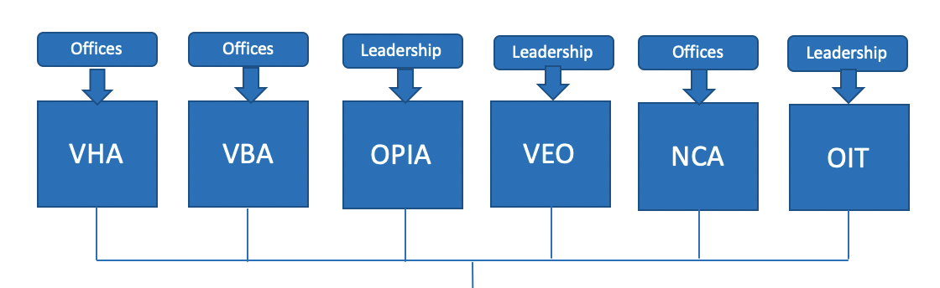
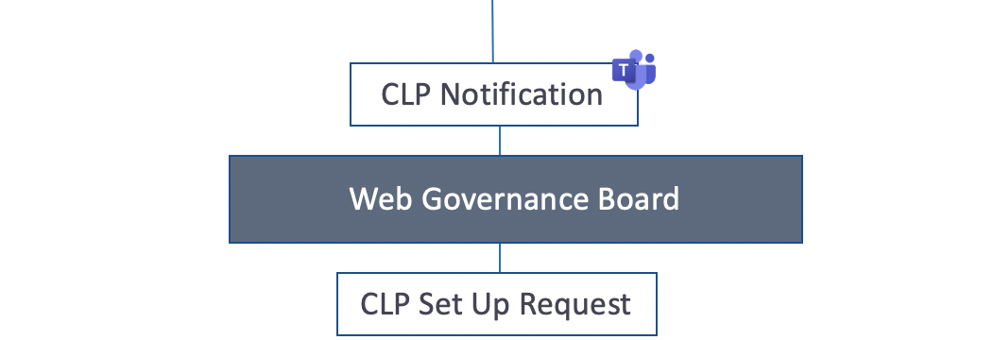
Approved Governance Model*
* Codified by the Web Governance Board on July 15, 2021
Business Owners
How It Works
VA.gov Product and CMS teams will assist with URL (root and vanity) and analytics set-up
Product
VA.gov Product

Slide 7
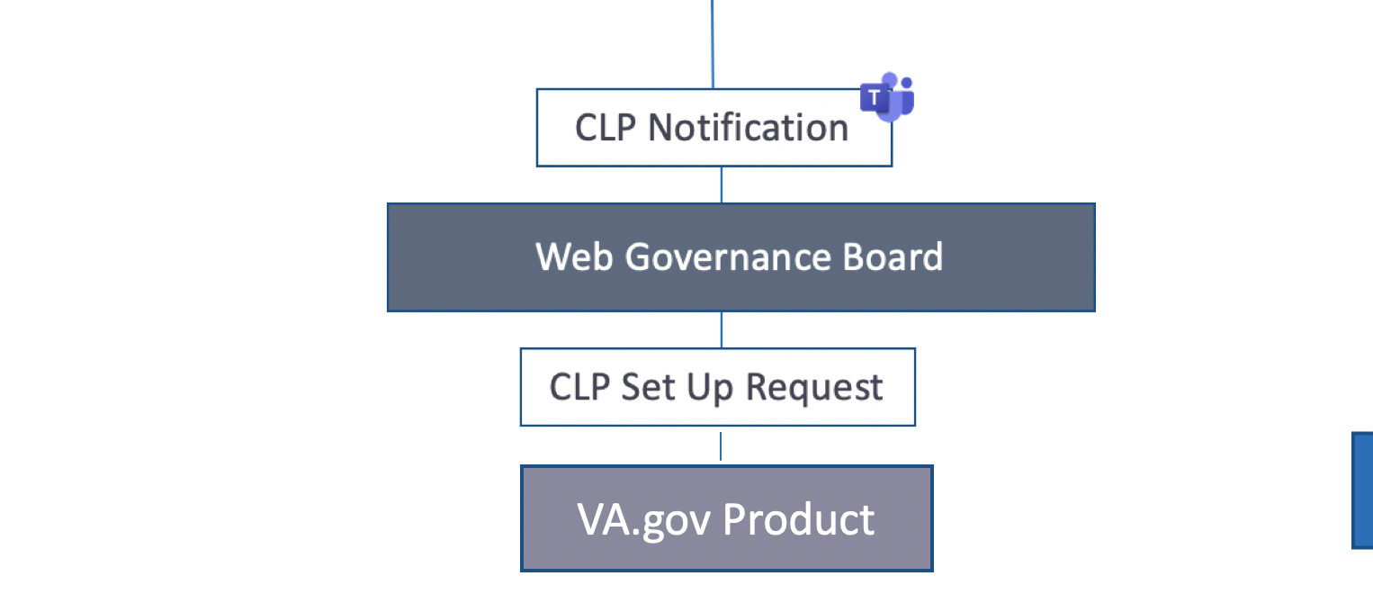
Approved Governance Model*
* Codified by the Web Governance Board on July 15, 2021
Business Owners
How It Works
VACO Digital Comms teams build or oversee the build of the CLP
Publish page
Manage any page updates
Create and implement share links (UTMs)
Monitor CLP performance (via Google Analytics)
Request “take down” of page when campaign ends, specifying the redirect strategy/URL
How It Works
Product
VA.gov Product and CMS teams will assist with URL (root and vanity) and analytics set-up
CLP Page Build, Publish & Manage
Business
CLP Take Down
Notes:
NOTES:
CMS or Product team will have to do Cloning, for now
Take Down -- Editors can already archive content (removes Page from VA.gov)
Account Admin – VACO may be able to request account (who has power to request account)

Slide 8
Campaign Landing Page: The Set-Up Questions
The What: Veterans Experience Action Center
The Who: VEO (Tim Hudak)
The Goal(s): Connect Veterans and their families to local and VA resources. Rapidly process their claims and enroll them In VA health care.
Target Audience: Veterans, Families, Survivors
Campaign start/end dates: 7/30 - 11/22
Seasonal Campaign (e.g. Get Your Flu Vaccine, Pride Month) : No. (If Yes, page will be “archived”)
Preferred URL: va.gov/Initiatives/veteran-action-center
Preferred vanity URL:
Retirement strategy: Retired Is fine since this "pilot" may be converted to a standard program by then and thus maybe we have a different website built.
Context: For the Veterans Experience Action Centers campaign a location is selected each month where we host an enrollment fair (virtual for now). In less than a few hours, Veterans go from NOTHING to having a FULLY ADJUDICATED claim and enrolled in VA health care. This https://booknow.appointment-plus.com/ch422seq/ is our current registration page. We are getting about 4% conversion from visitors to sign up. The concern is that the current page is ineffective in communicating the value of this program and driving sign-ups.
Notes:
NOTES:
CMS or Product team will have to do Cloning, for now
Take Down -- Editors can already archive content (removes Page from VA.gov)
Account Admin – VACO may be able to request account (who has power to request account)

Slide 9
On-Boarding & Training Model
On-Boarding and Training for VACO Digital Comms Teams
To request CMS access for a new CLP editor - https://prod.cms.va.gov/help/cms-basics/how-to-request-a-cms-account
VA.gov CMS and CLP Training
CMS Basics - https://prod.cms.va.gov/help/cms-basics
Campaign Landing Page Usage Guide - https://prod.cms.va.gov/help/campaign-landing-pages/campaign-landing-pages
Note: We expect experienced CLP users – e.g., Tim Hudak at VEO & John Santos at OPIA -- to train their teammates. There are no plans for the CMS team to provide in-person training.
Business Owners
Product Support and Requests
Key documents, including Content Build Template and Social Share (UTM) Worksheet available in this Teams/Sharepoint folder – https://teams.microsoft.com/_#/files/General?threadId=19%3A0PwhhN1I-X_rH2qjwRgqZSbQXA8PKa53mL_0OKm-xpM1%40thread.tacv2&ctx=channel&context=General&rootfolder=%252Fsites%252FCampaignLandingPage%252FShared%2520Documents%252FGeneral
Creating a New CLP → Contact VA.gov Product Manager Brian Lloyd at brian.lloyd1@va.gov
Issues (CMS authoring and/or Front-end experience) → Contact CMS Help Desk
New Feature requests (CMS authoring and/or Front-end experience) → quarterly meetings with VA.gov Product & CMS leads → Contact VA.gov Product Manager Brian Lloyd at brian.lloyd1@va.gov

Slide 10
Campaign Landing Page
Product Guide
Campaign Landing Page
Product & Governance Guide
June 2021

Slide 11
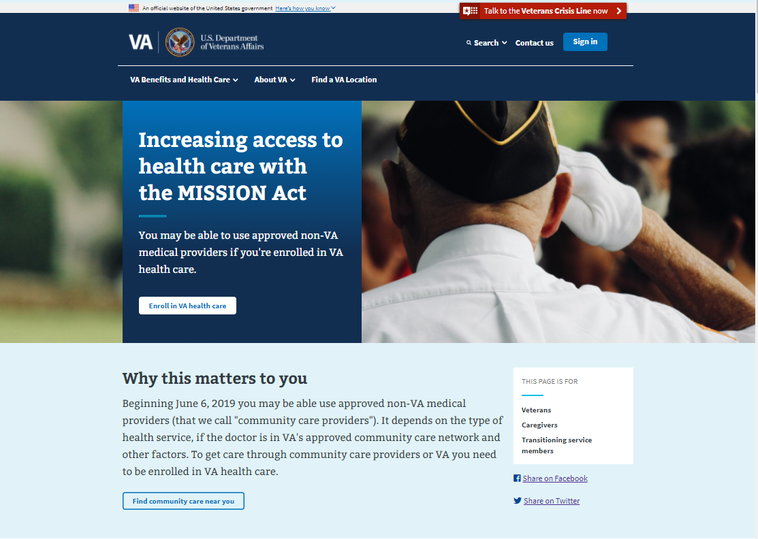
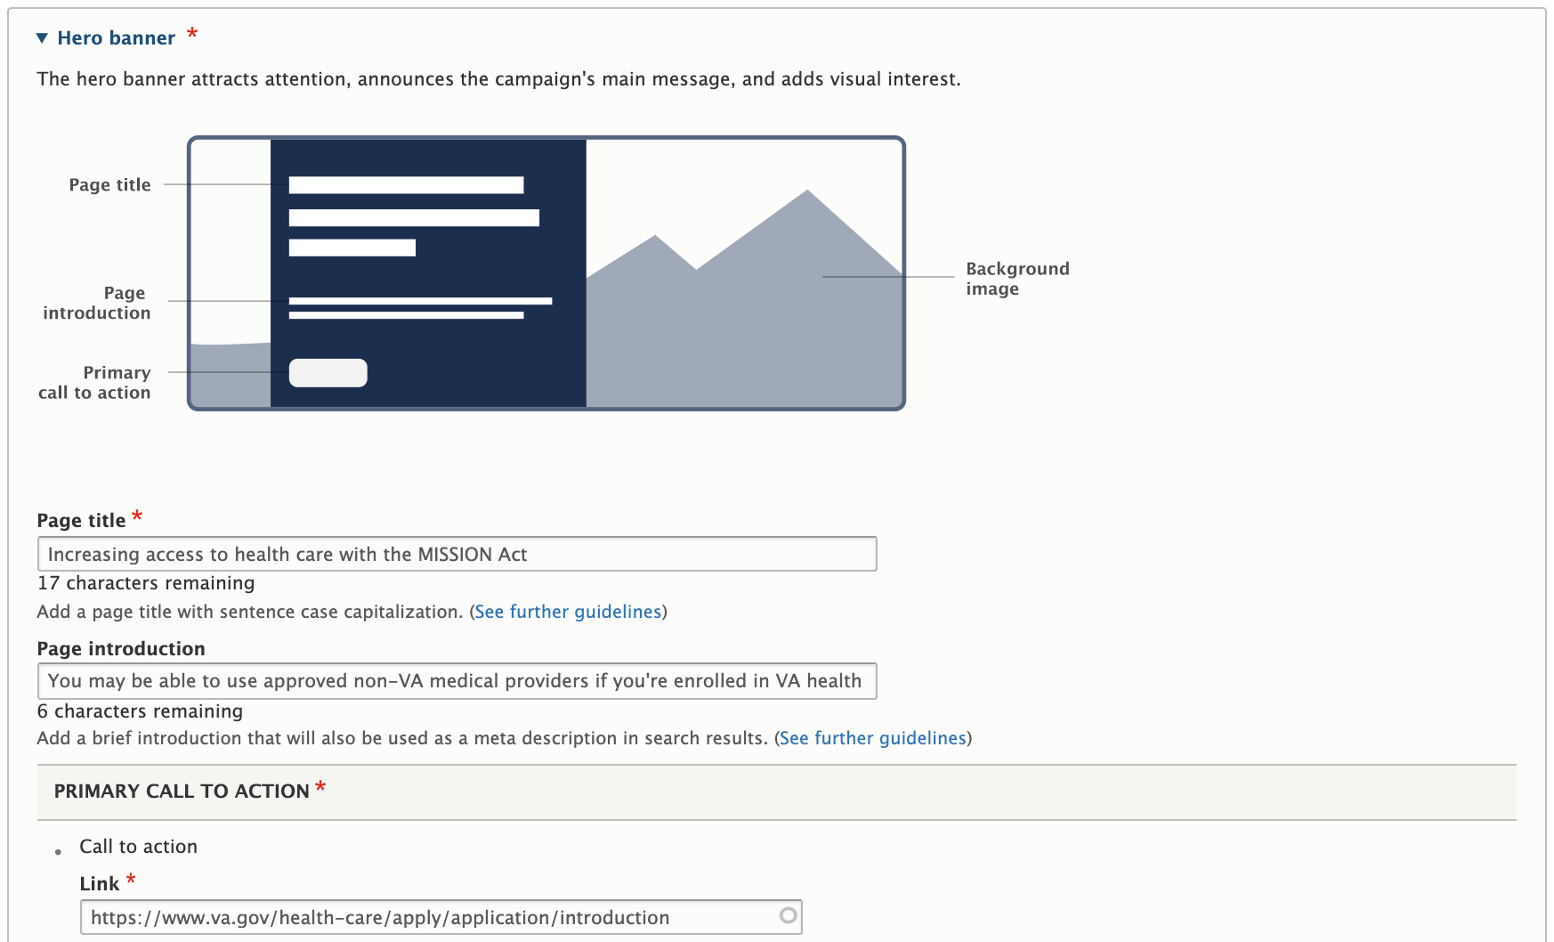
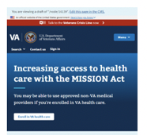
Campaign Landing Page: The Building Blocks
Panel #1 - Hero Banner (required)
The Hero banner panel attracts attention, announces the campaign’s main message and adds visual interest.
Web Page View
CMS Editor View
Mobile View

Slide 12
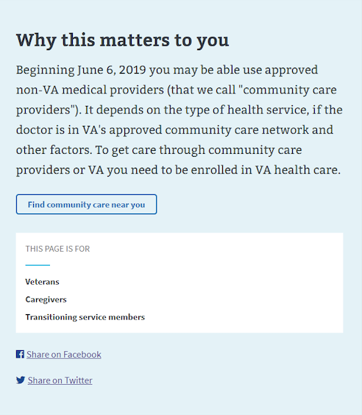
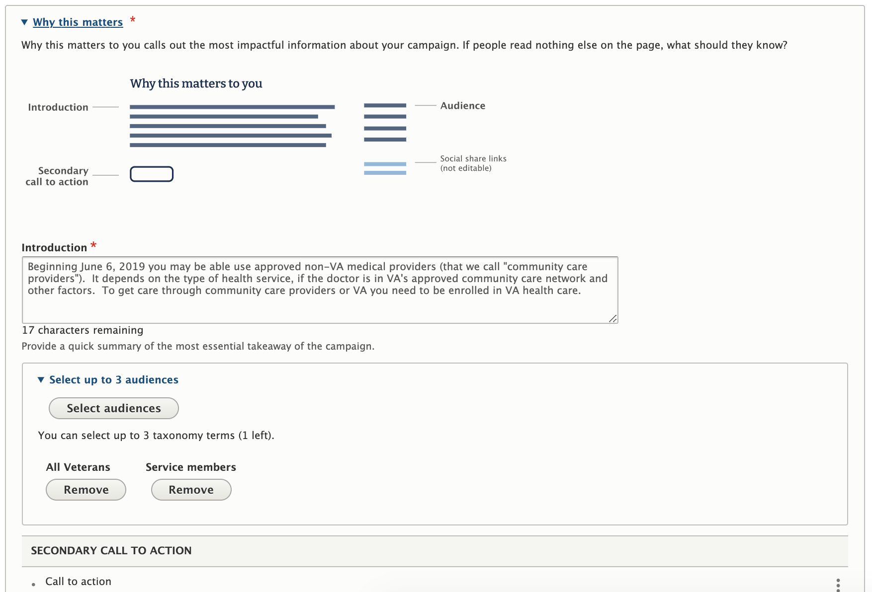
Campaign Landing Page: The Building Blocks
Panel #2 – Why this matters to you (required)
The Why this matters to you panel calls out the most impactful information about your campaign and the intended audience, e.g. If people read nothing else on the page, what should they know?
Web Page View
Mobile View
CMS Editor View

Slide 13
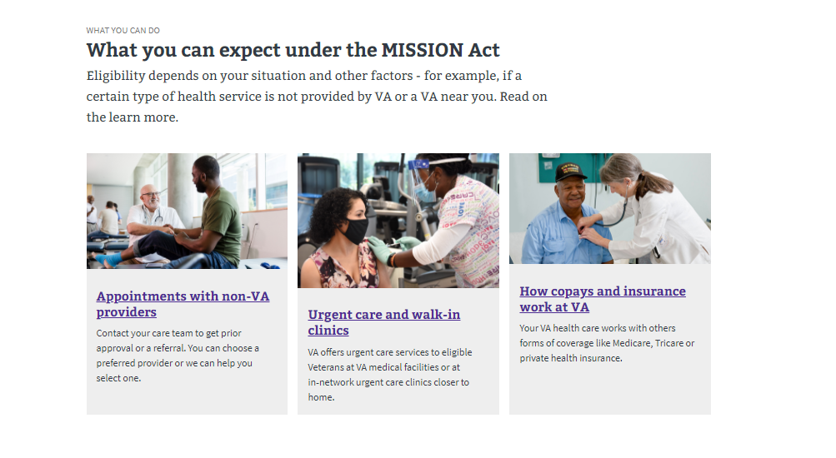
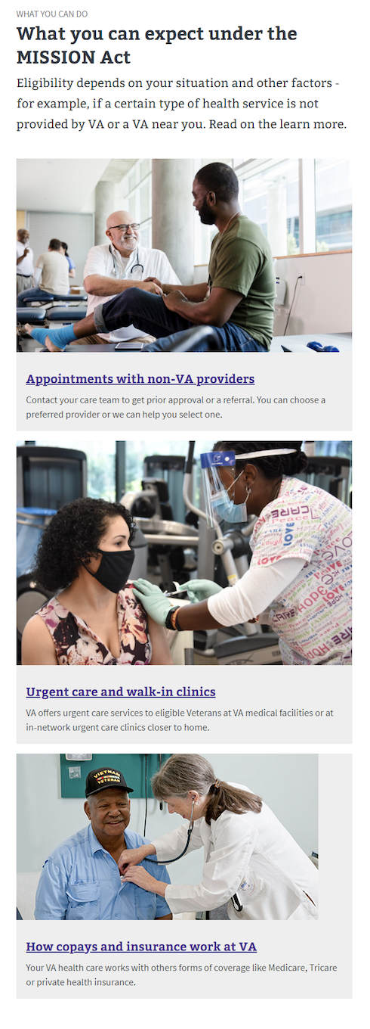
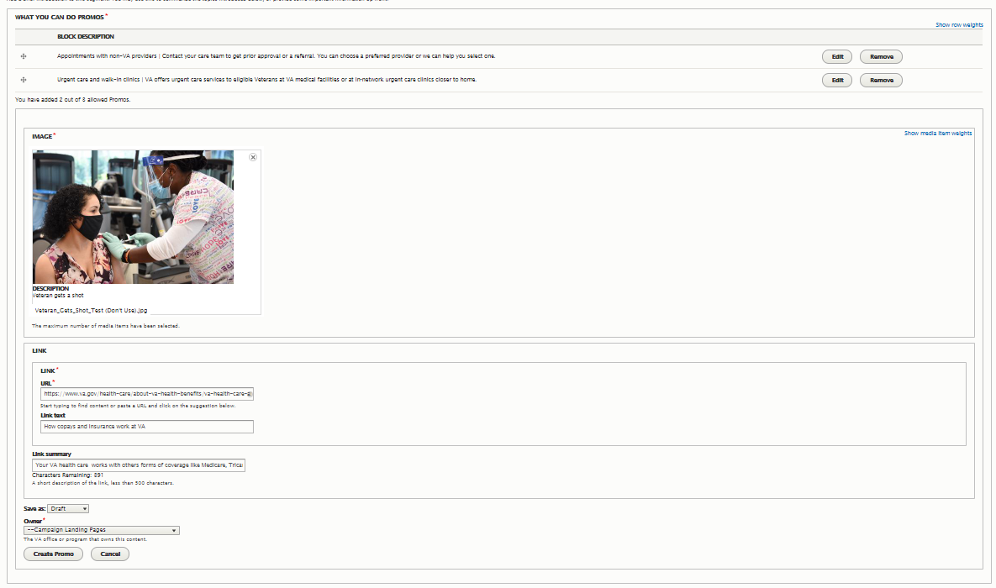
Campaign Landing Page: The Building Blocks
Panel #3 – What you can do (required)
The What you can do panel focuses on actions or steps that the CLP target audience can or should take. The panel includes up to three “promos” – content formatted as text and image teasers that engage attention and inspire further action.
Web Page View
Mobile View
CMS Editor View

Slide 14
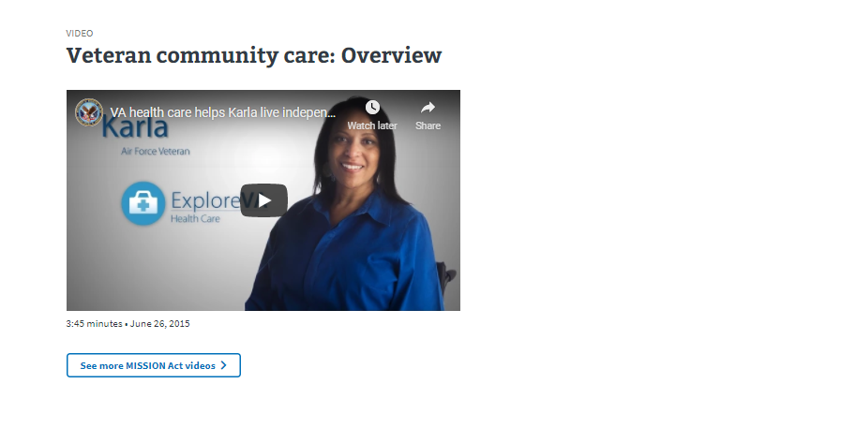
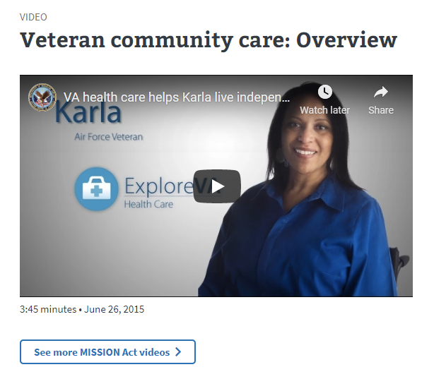
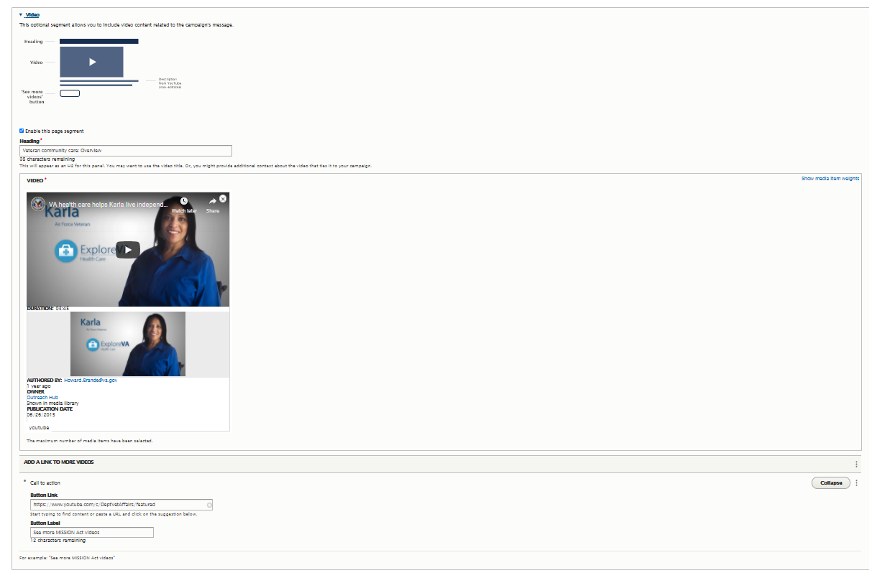
Campaign Landing Page: The Building Blocks
Panel #4 – Video (optional)
The optional Video panel provides video content related to the campaign’s message.
Web Page View
Mobile View
CMS Editor View

Slide 15
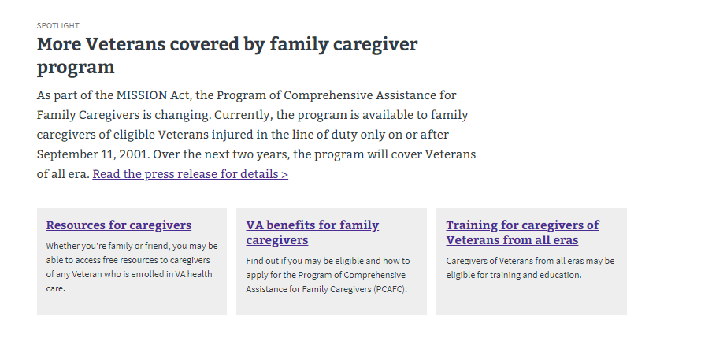
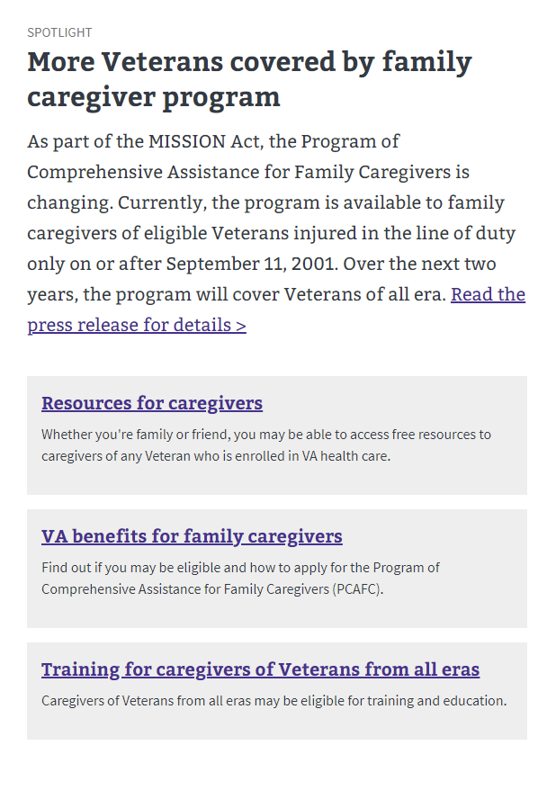
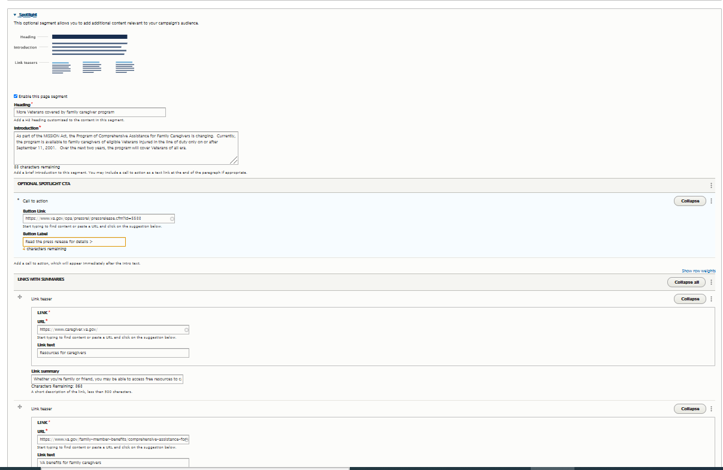
Campaign Landing Page: The Building Blocks
Panel #5 – Spotlight (optional)
The optional Spotlight panel – with up to three link teasers -- provides additional content – articles, blog posts – relevant to your campaign’s audience.
Web Page View
Mobile View
CMS Editor View

Slide 16
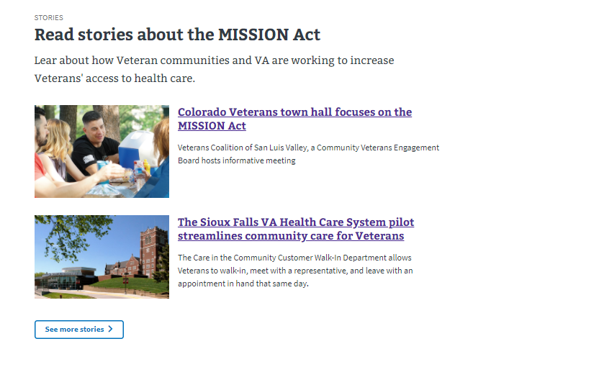
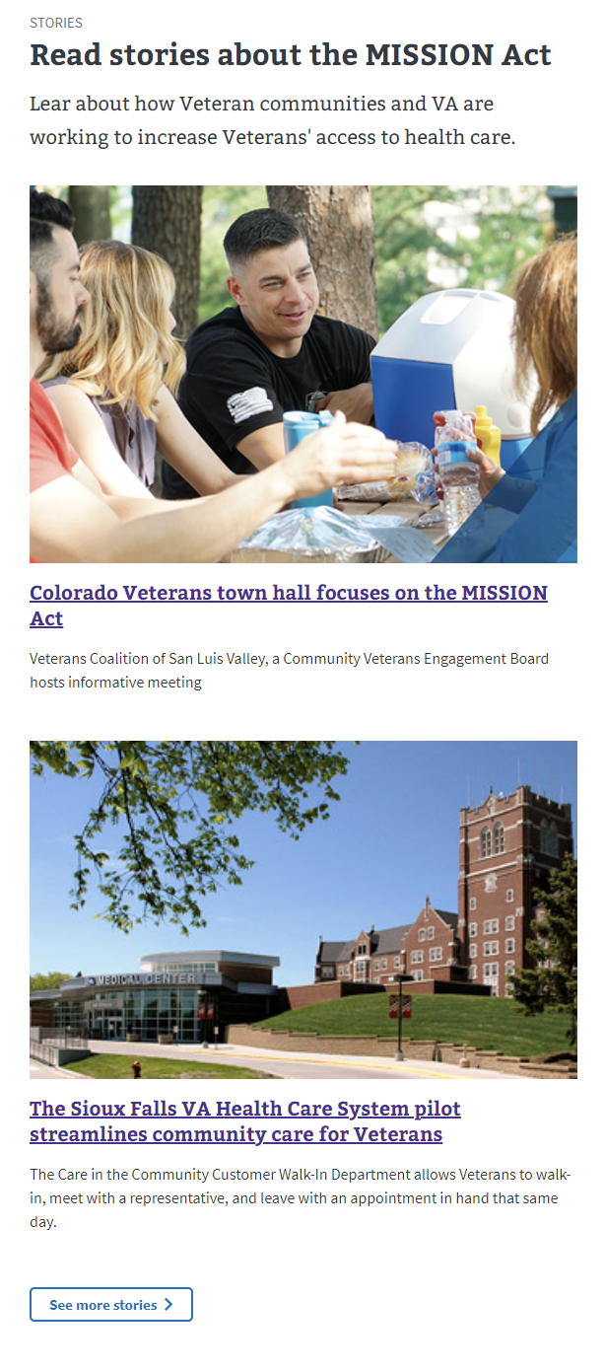
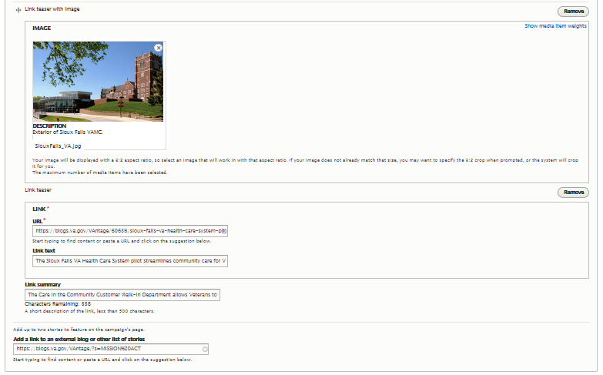
Campaign Landing Page: The Building Blocks
Panel #6 – Stories (optional)
The optional Stories panel features a link and a teaser text for up to two stories that support the campaign’s main message.
Web Page View
Mobile View
CMS Editor View

Slide 17
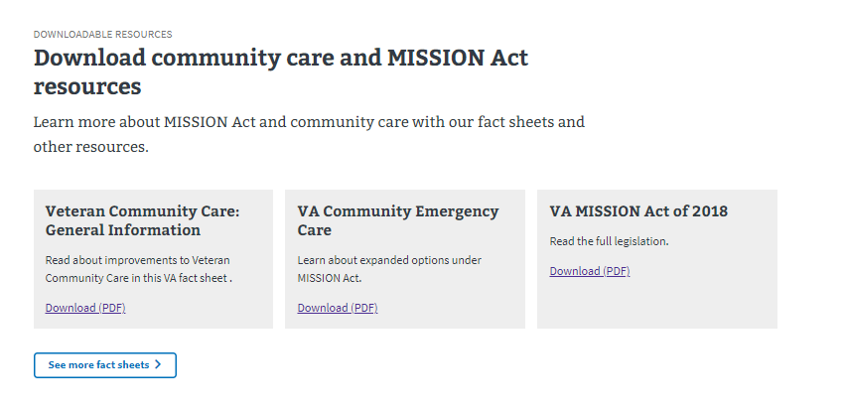
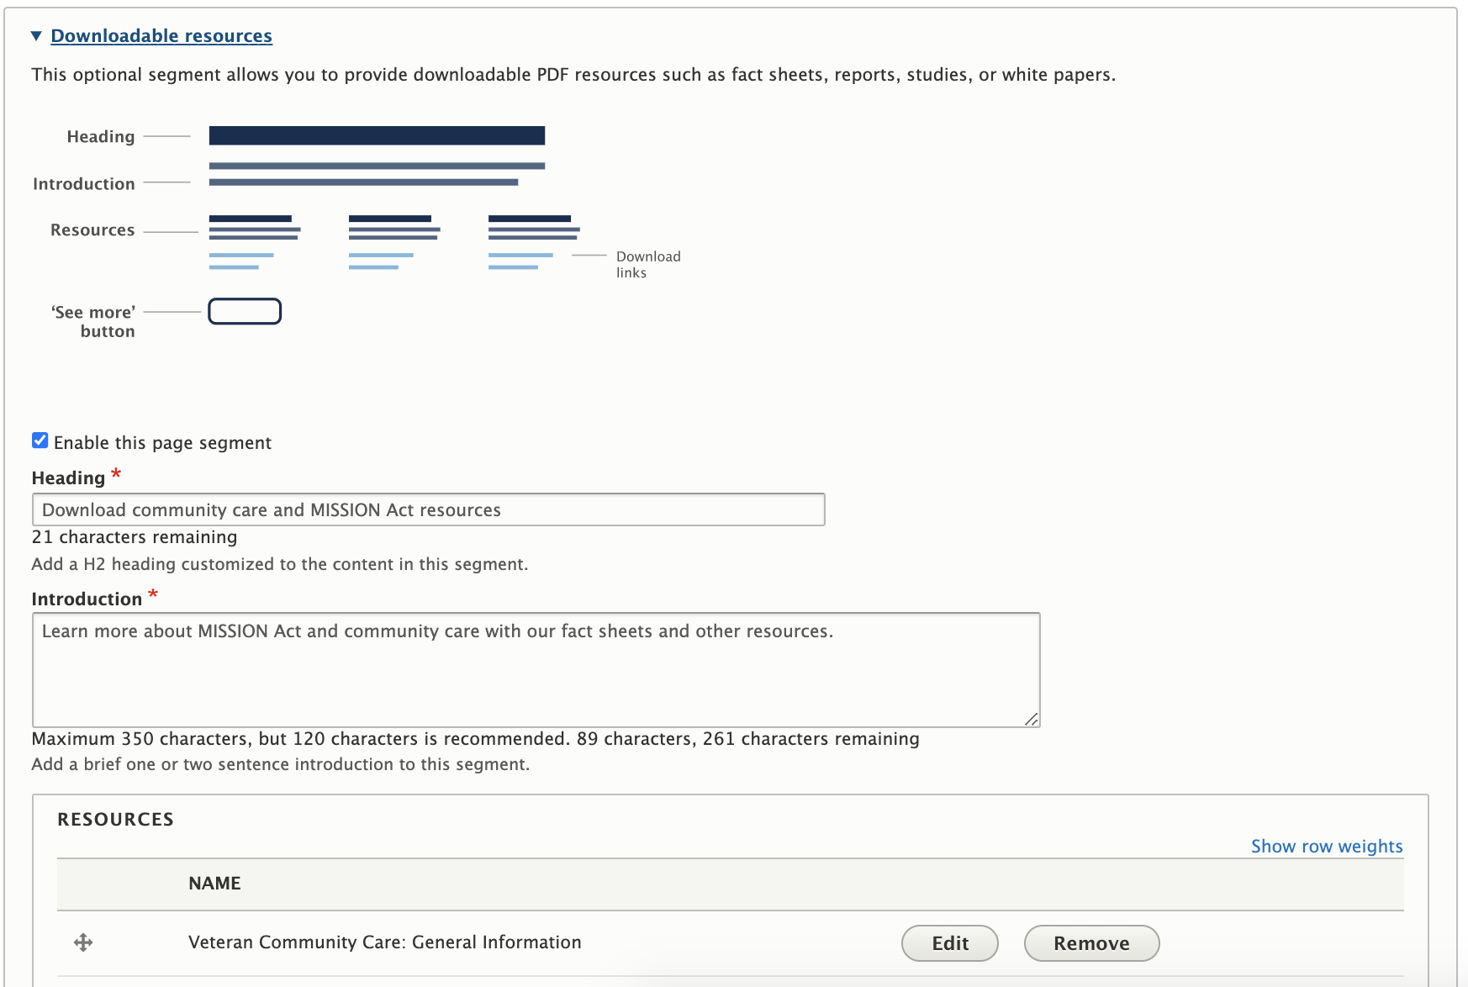
Campaign Landing Page: The Building Blocks
Panel #7 – Downloadable resources (optional)
The optional Downloadable resources panel provides downloadable PDF resources such as fact sheets, reports, studies or white papers.
Web Page View
Mobile View
CMS Editor View

Slide 18
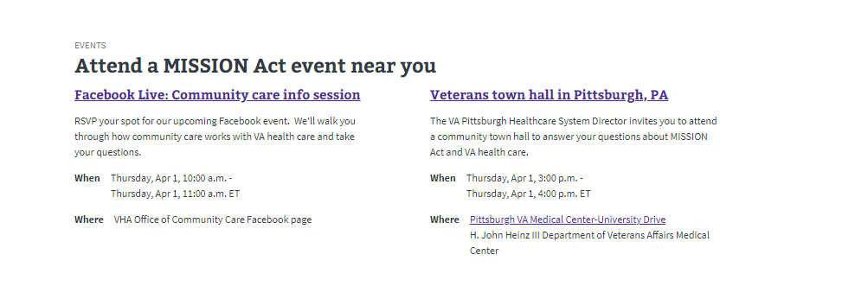
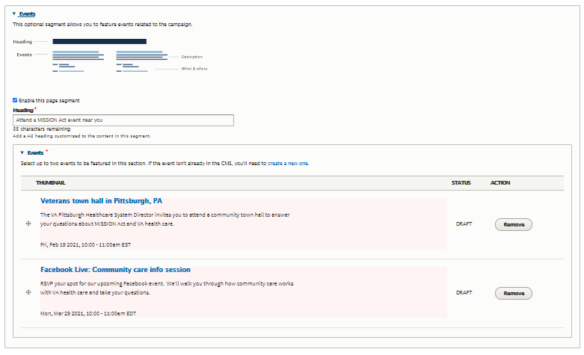
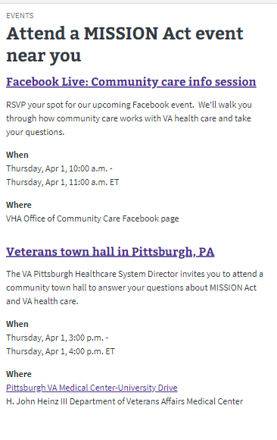
Campaign Landing Page: The Building Blocks
Panel #8 – Events (optional)
The optional Events panel is used to feature information about VA events (online and in real life) related to the campaign.
Web Page View
Mobile View
CMS Editor View

Slide 19
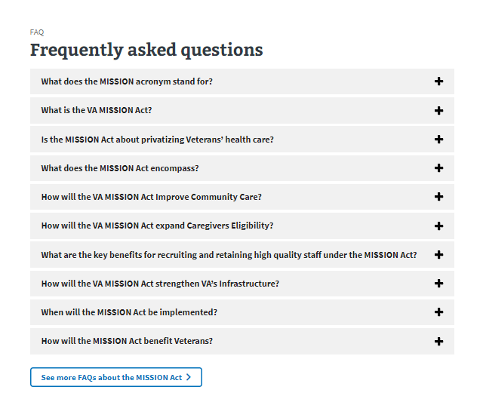
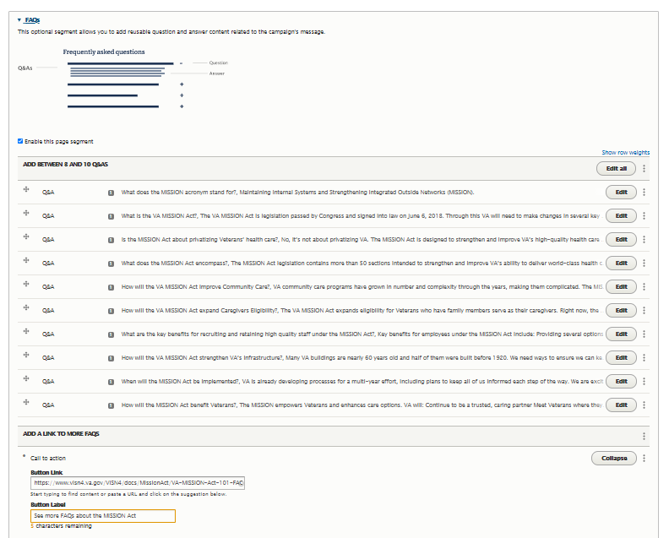
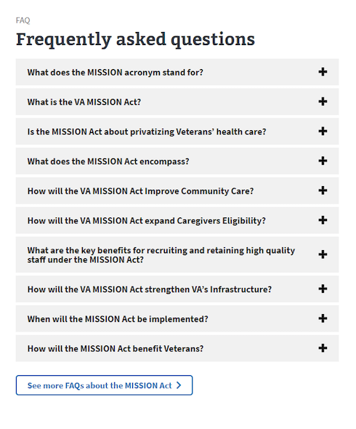
Campaign Landing Page: The Building Blocks
Panel #9 – Frequently asked questions (optional)
The optional FAQs (frequently asked questions) panel features up to ten question and answer content related to the campaign’s message.
Web Page View
Mobile View
CMS Editor View

Slide 20
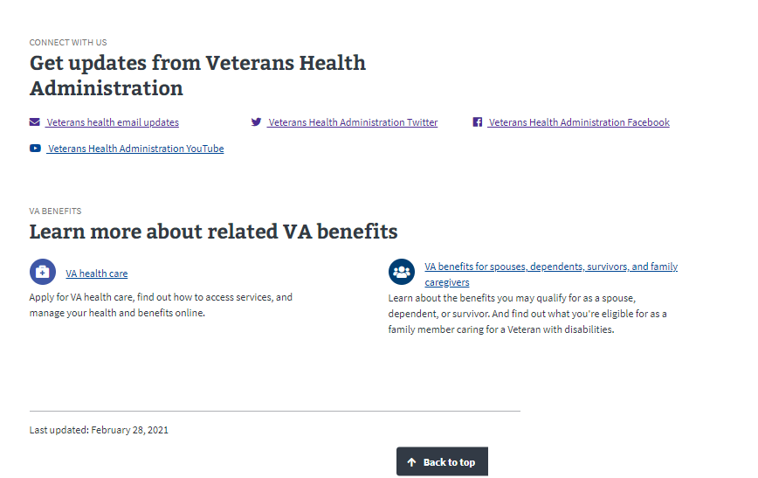

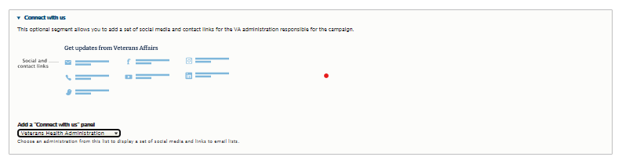
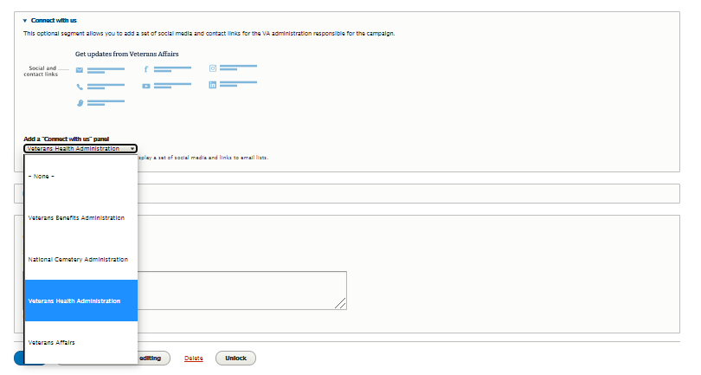
Campaign Landing Page: The Building Blocks
Panel #10 – Connect with us (optional)
The optional Connect with us panel features social media and contact links for the VA administration responsible for the campaign.
Web Page View
Mobile View
CMS Editor View

Slide 21
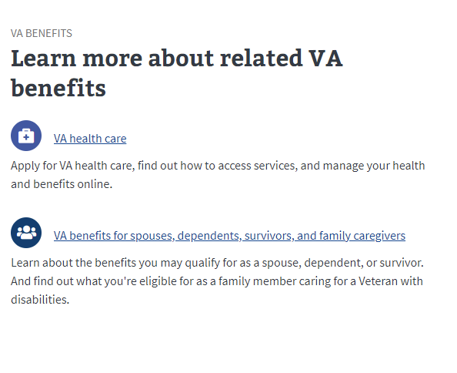
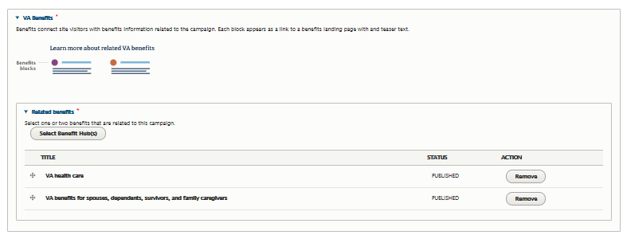
Campaign Landing Page: The Building Blocks
Panel #11 – VA benefits (required)
The required VA benefits panel connects the audience with benefit information related to the campaign.
Web Page View
Mobile View
CMS Editor View

